Slide 1

KHALID SWAID-324264530
LAYAN AMER -323068700
SAFA KHIER -322829102
NABI MARI- 316197490

Slide 2
Introduction to IBM Cloud
IBM Cloud offers diverse cloud computing services like IaaS, SaaS, and PaaS, empowering businesses to innovate and scale. It serves as a comprehensive platform for digital transformation.

Slide 3
Exploring IBM Cloud
Navigate a user-friendly portal to access AI-driven analytics, virtual servers, and custom applications. It's a go-to destination for professionals seeking scalable cloud solutions.

Slide 4
customer requirement
We identified the need for a search engine that simplifies access to relevant links from https://www.ibm.com/cloud.
Our goal is to provide users with a seamless browsing experience, eliminating the complexities often associated with traditional search methods.
Our platform is designed to be intuitive and engaging, ensuring that users find the information they need efficiently and effortlessly.

Slide 5

Our solution – Cisearch
Functional Requirements | Non-Functional Requirements
- Search Function | - Execution – Make sure the engine will las within 2 seconds
- Content recommendation | - Expansion – System must handle large number of users without a decrease in performance
- Interactive instructions | - Security - Implement secure connections to user data and operations
- Community forum | - Accessibility – Interface must be ensured to be accessible and user-friendly
- Mobile acccess | - Reliability – ensure 99.9% availability of the platform

Slide 6





Architecture
ClSearch
Code
Build Database Code

Slide 7
Iterations
Iteration 1 Roles | Iteration 2 Roles:
Product Manager and Scrum Master – Layan Amer | Product Manager and Scrum Master – Khalid Sweid
Frontend Developer and UI – Safa Kheir | Frontend Developer and UI – Nabi Mari
Backend Developer – Khalid Sweid | Backend Developer – Safa Kheir
QA –Nabi Mari | QA – Layan Amer

Slide 8
Iterations
Iteration 1 Tasks: | Iteration 2 Tasks:
Defining requirements | Implementing the rest of CISearch functionality and advanced search algorithms.
Making UML diagram for initial planning | Upgrading CISearch with new search algorithms to make it more effective
Web page design planning | Integrating user feedback for UI/UX improvements
Backend Implementations | Enhancing backend for better performance and scalability
Building a prototype | Adding advanced search filters and result categorization
Running acceptance tests | Running acceptance tests for overall system functionality
Getting client feedback | Implementing user account and customization features

Slide 9
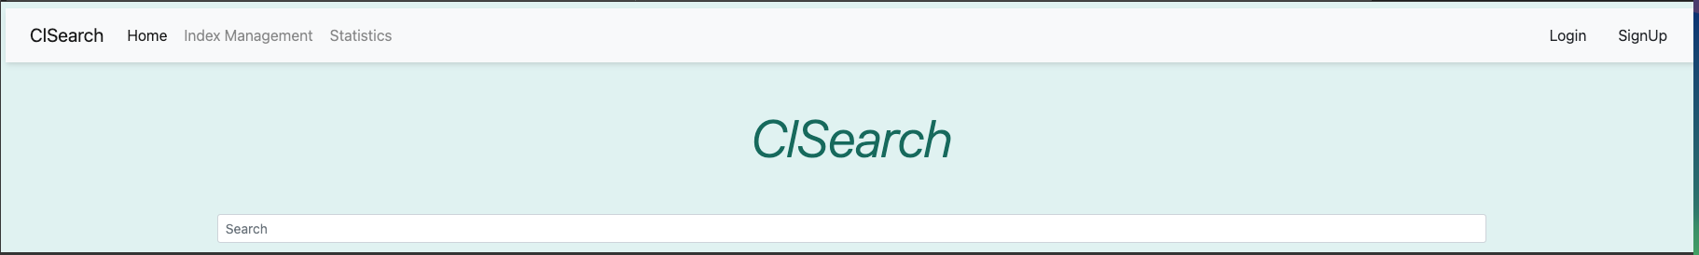
Home page

Slide 10
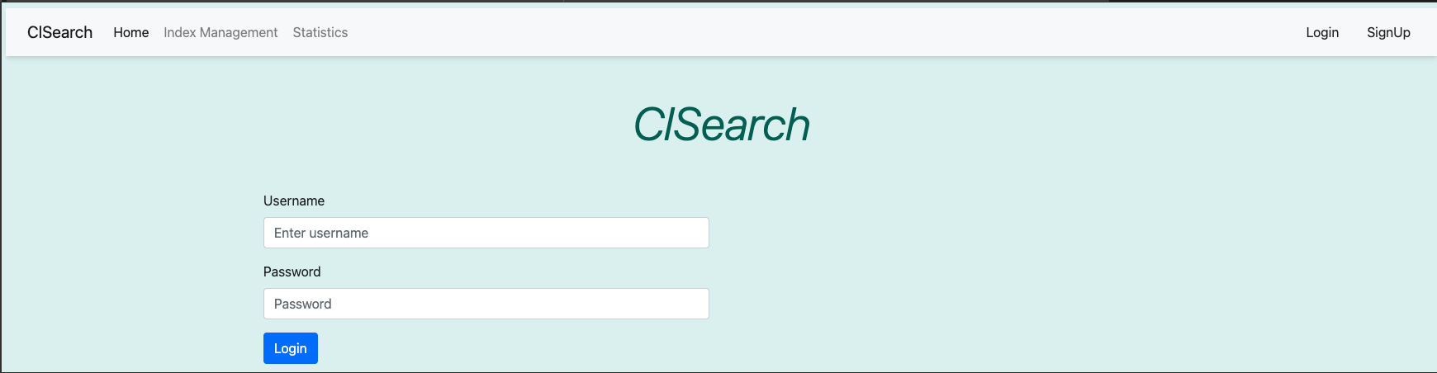
Login page

Slide 11
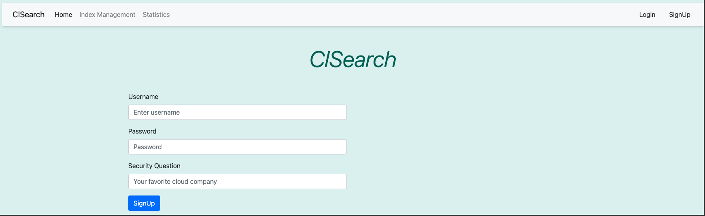
signup page

Slide 12
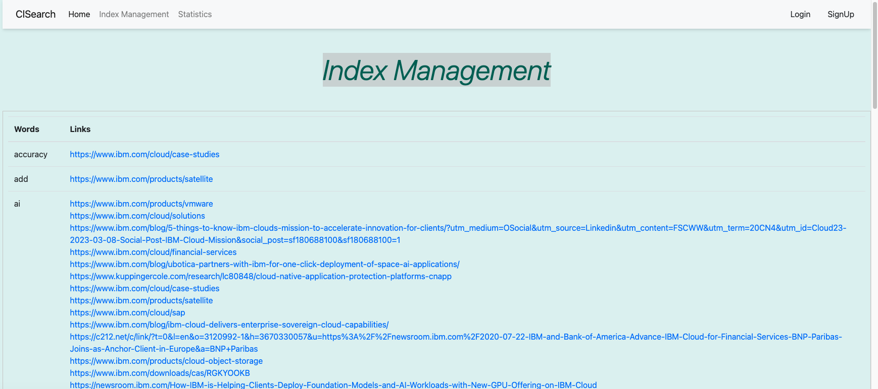
Index management page

Slide 13
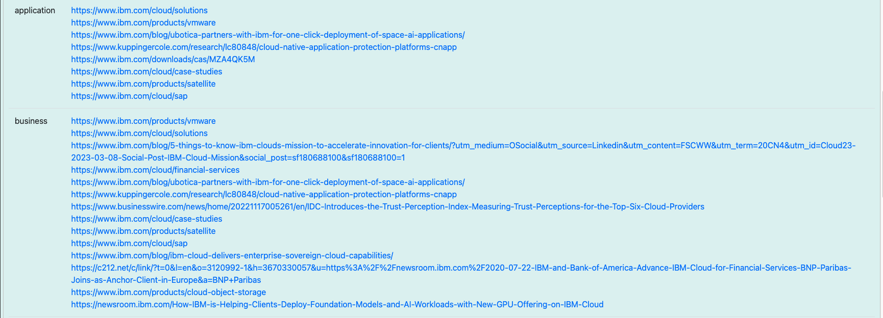
Index management page

Slide 14
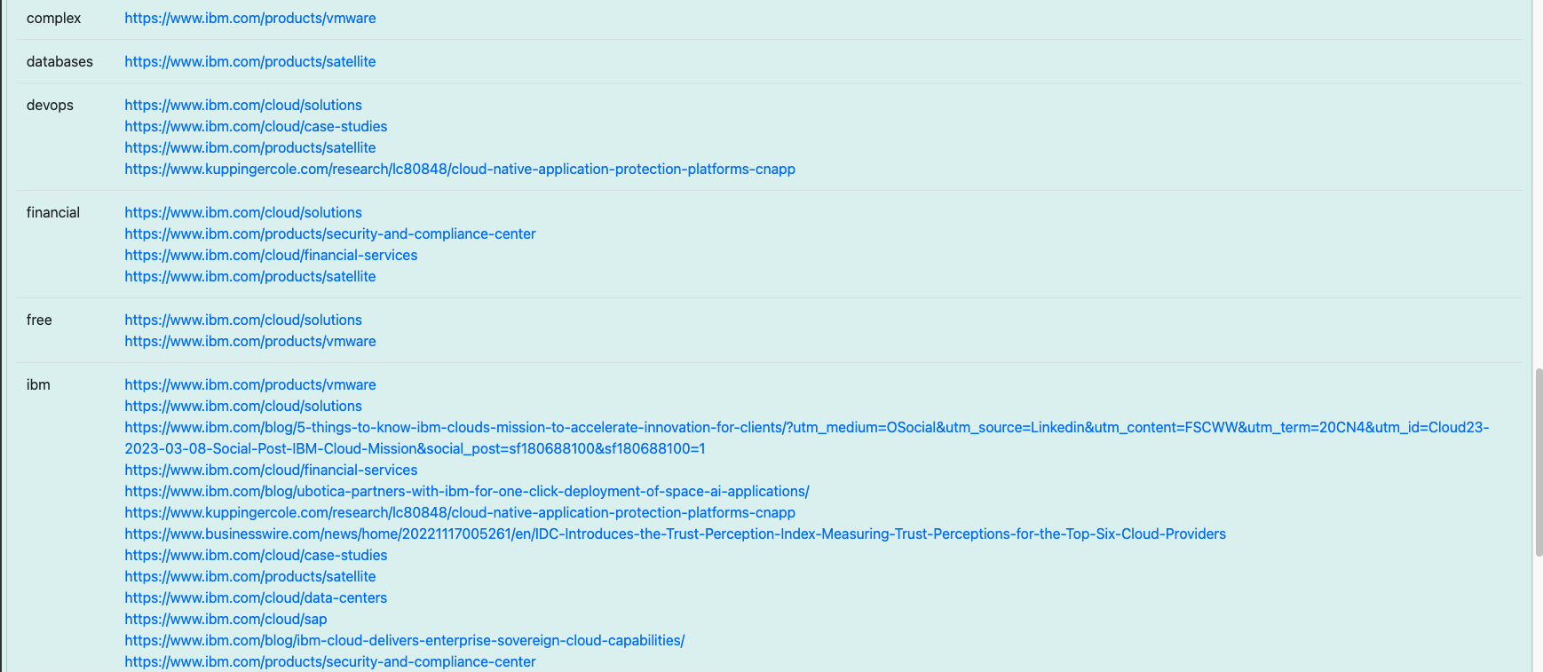
Index management page

Slide 15
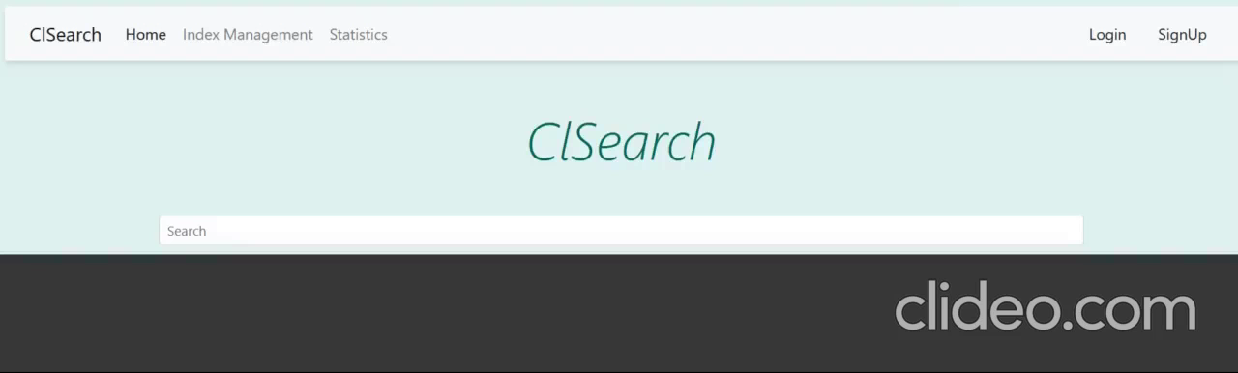

Slide 16

Thank you

